Slide 1
Human Computer Interaction
Group number : 24
Group members
10707417 - H.J.K.I.Wijerama
10707129 - K.L.D.Anupama
10707216-K.Charuka Heshan
10713401-U.R.K.Ukwatta
10707256 - N.N.D.G.Liyanage

Slide 2
Agriculture information system

Slide 3
Introduction
The Agricultural information system is a valuable and important source, has been revealed by the developing technological world. According to the path of reaching from system owner to the system user, system framework must be differing. However, in present there are two category of system. Such as good and bad. Because of that persons are creating these two type of system. Some of website creators do not know, what is the real deliverable to the customer, and they have not enough knowledge about that.
Leora AGRO is an agricultural developing company in sri lanka . we do best dor sri lankan agriculture. this system allows farmers and customers to have access to 8 types of services. It will help the farmers by giving real time information and inspiring the farmers to require up farming activities at right time.

Slide 4
ID :10707417
Name :H.J.K.I.Wijerama

Slide 5
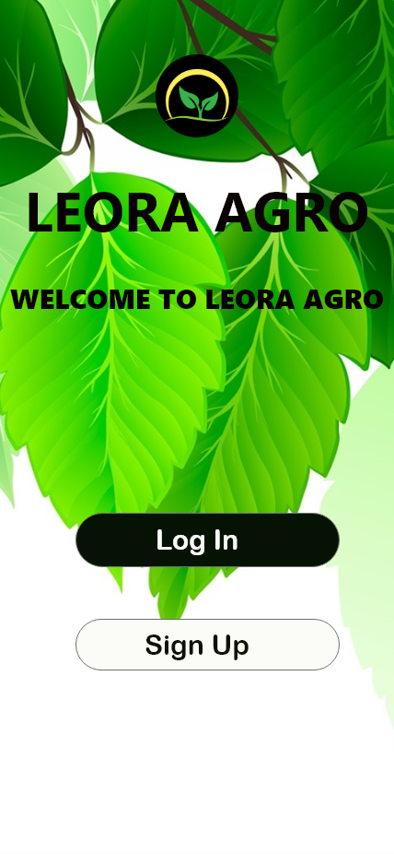
Main page
This is the first page of the agriculture information system.Its very user friendly.User can easily understand what to do.Login and sign up buttons are very clear to understand.We design a logo for our system .

Slide 6
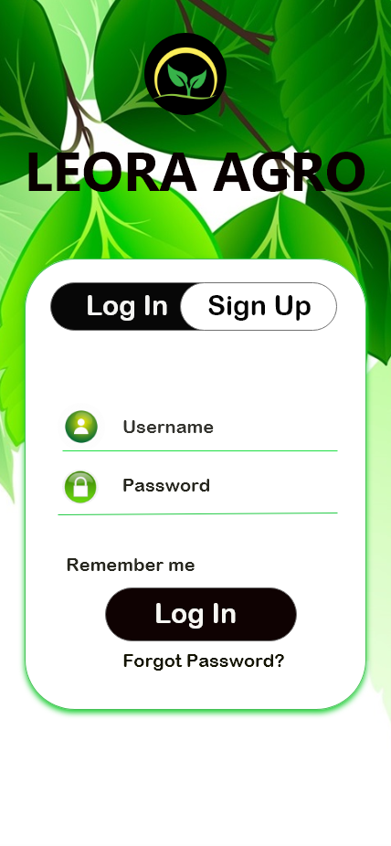
Login page
This is the login page.When user click on the login button it will redirect to this page.It is very user friendly interface .We use clarity for this interface , anyone who use this interface can understand what is the function of this interface,This will increase the efficiency of the interface.We use eye comfort colors,big buttons to get user attention.In this login form we use icons to login details then user can recognize it quickly.

Slide 7
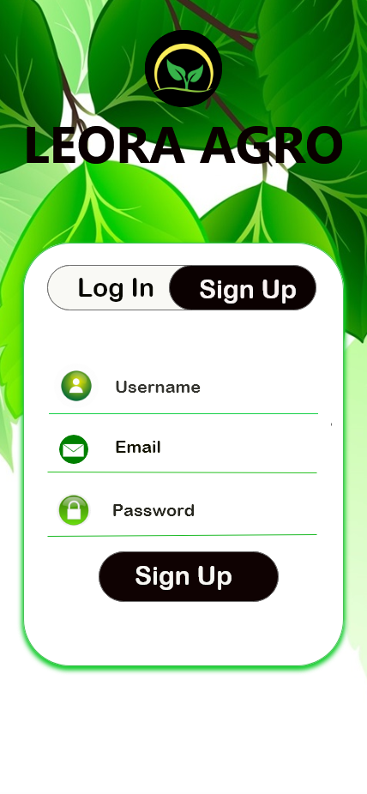
sign up page
This is sign up form.When user first came to our system,they don’t have account to log in.Then they must create an account .Sign up form will help to do that.When user click on the sign up button it will redirect to the sign up form.User can easily recognize about this interface, We use different colors different sizes font to get user attention.We design a logo to identify easily for user.back ground image also matches to the our purpose of this system.

Slide 8
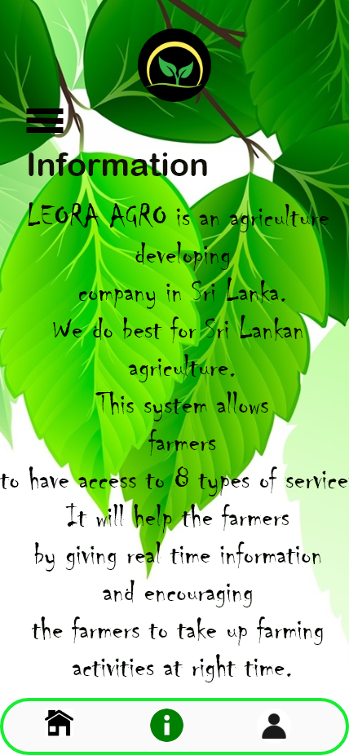
Information page
This is the information interface.It will show the small paragraph about interface.User can get overall idea from this.We use different font family to title and description.

Slide 9
ID :10707129
Name :K.L.D.Anupama

Slide 10
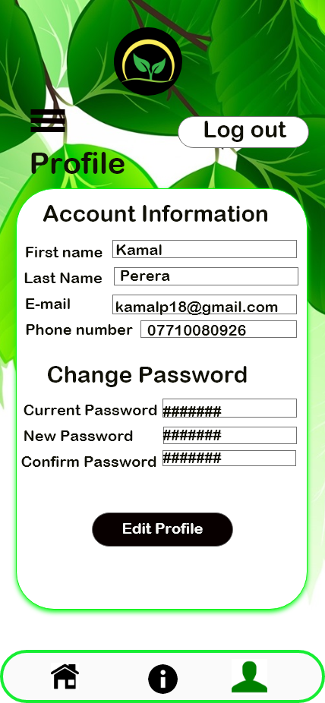
user profile
This is the user profile interface , when user login to our system their details will show there.user can change password as they wish. User can edit there profile.It is very useful feature .When user came to this page user able to understand whats the function of this UI .We use different color buttons for different functions.we can get user attention by doing that.

Slide 11
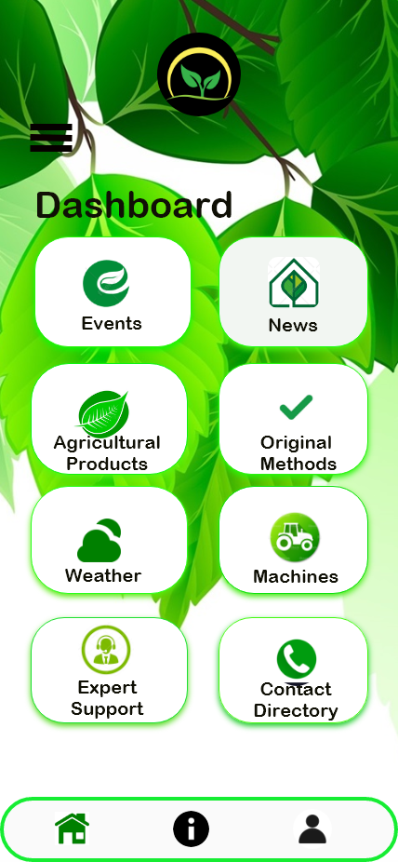
Dashboard
This interface called dashboard UI.It represents the all buttons to go to other interface.User able to understand it very easily.When user click on the button it will goes to another page.Buttons use text and icon(sign language) about the button , so user can recognize it quickly.We divide into three parts of footer part ,it is also highlight.Buttons are big and place neatly to get user attention.

Slide 12
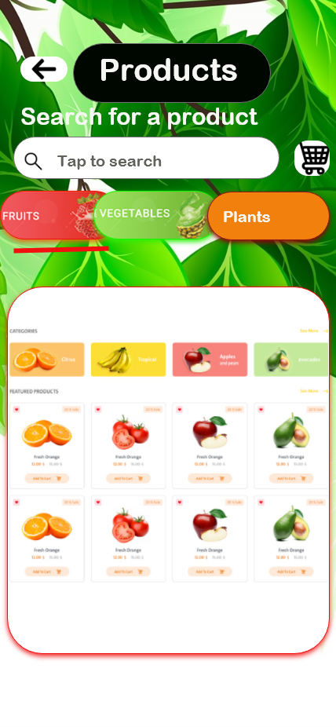
Agriculture Products - fruits
This is the product interface.Its show the products that user can buy.User can select item/items and add them to cart.In this interface user can search items.There are 3 categories of products , fruits,vegetables,plants.This interface shows about fruits.There is a cart symbol which user able to recognize easily.

Slide 13
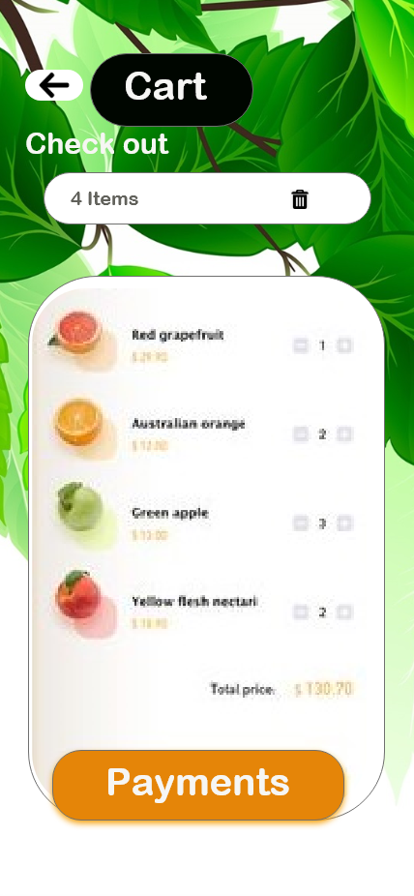
Cart
This is the cart page of our agricultural information system. When user click on the cart icon it will redirect to this vegitable page. . Those things added to the cart. It is very user friendly interface .We use clarity for this interface , anyone who use this interface can understand what is the function of this interface,This will increase the efficiency of the interface.We use eye comfort colors,big buttons, large size font to get user attention.In this fruit product form we use icons to details then user can recognize it quickly. After creating the UI style guide. The overall user interface design was done to keep the website having a sense of good health and full of nutrition.

Slide 14
ID :10707256
Name :N.N.D.G.Liyanage

Slide 15
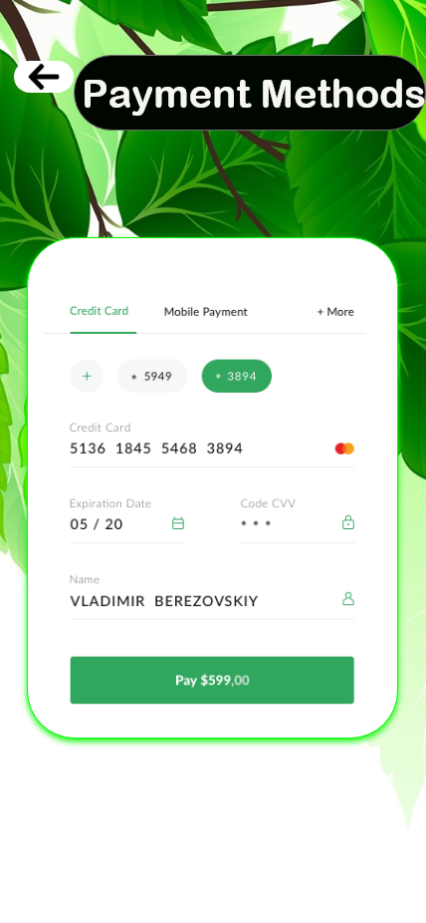
payment method
This is the payment methods page of our agricultural information system. uses a interface for the payment method selection during checkout. Notice how all the options are placed in close proximity so the user will perceive them as a collection and compare them to one another. Furthermore, the tabbed design makes it abundantly clear which option is currently selected and ensures that only form fields relevant to the current selection are displayed. Finally, Best Buy have made “Credit Card” the default choice so the user doesn’t have to stop and think but can simply proceed unless they want to make use of one of the other secondary payment methods accepted.
. It is very user friendly interface .We use clarity for this interface , anyone who use this interface can understand what is the function of this interface,This will increase the efficiency of the interface.We use eye comfort colors,big buttons, large size font to get user attention. We use eye comfort colors,big buttons, large size font to get user attention.In this fruit product form we use icons to details then user can recognize it quickly.

Slide 16
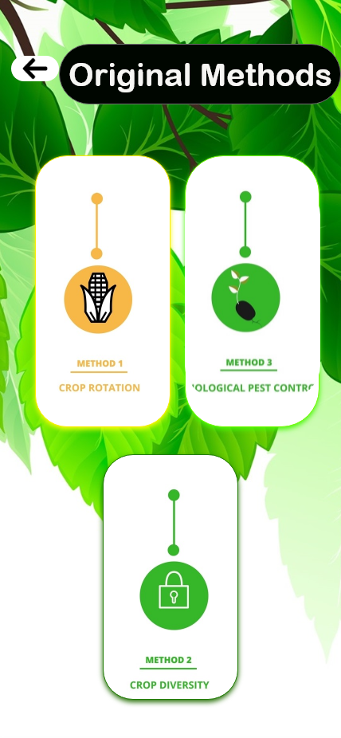
Original method
This is the original methods page of our agricultural information system. Here the search button allows the user to find the desired pages. The original methods are shown by a 3 parts . There are crop rotation, biological pest control, and crop diversity. It is very user friendly interface .We use clarity for this interface , anyone who use this interface can understand what is the function of this interface,This will increase the efficiency of the interface.We use eye comfort colors,big buttons, large size font to get user attention.In this methods product form we use icons to details then user can recognize it quickly.

Slide 17
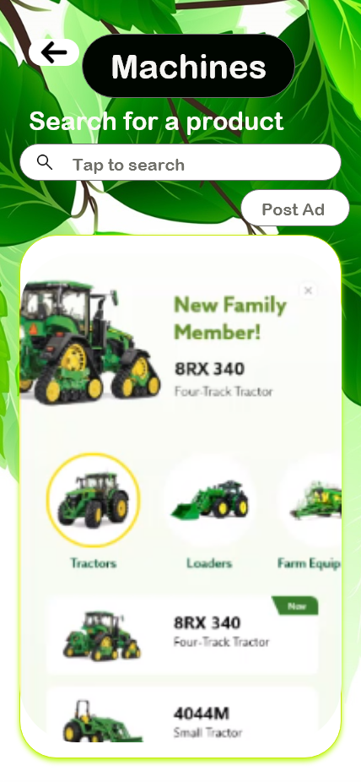
Machines
This is the machines page of our agricultural information system. When user click on the machines button it will redirect to this page. Here the search button allows the user to find the desired machines. It is very user friendly interface .We use clarity for this interface , anyone who use this interface can understand what is the function of this interface,This will increase the efficiency of the interface.We use eye comfort colors,big buttons, large size font to get user attention.In this fruit product form we use icons to details then user can recognize it quickly.

Slide 18
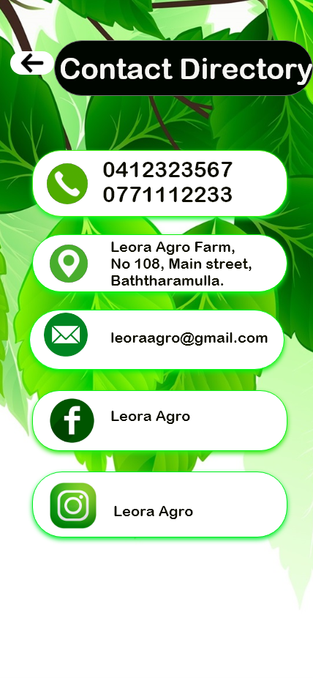
Contact Directory
This is the contact directory page of our agricultural information system. The telephone numbers, address, email address, facebook page and Instagram page are shown in the panels. It is very user friendly interface .We use clarity for this interface , anyone who use this interface can understand what is the function of this interface,This will increase the efficiency of the interface.We use eye comfort colors,big buttons, large size font to get user attention.In this fruit product form we use icons to details then user can recognize it quickly.

Slide 19
ID :10707216
Name :K.C.Heshan

Slide 20
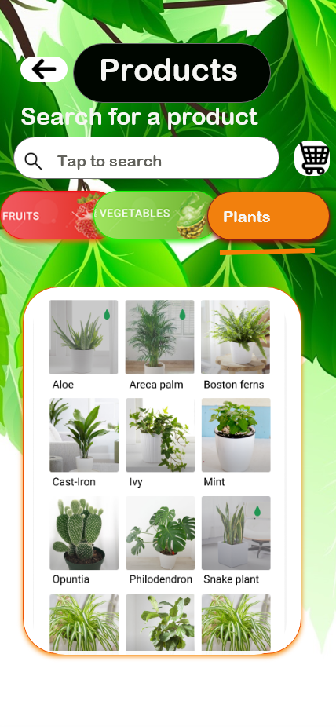
Agriculture Products-Plants
This is the Product page of our agricultural information system. When user click on the plants button it will redirect to this plant page. . Here the search button allows the user to find the desired plants. Those things added to the cart. It is very user friendly interface .We use clarity for this interface , anyone who use this interface can understand what is the function of this interface,This will increase the efficiency of the interface.We use eye comfort colors,big buttons, large size font to get user attention.In this fruit product form we use icons to details then user can recognize it quickly. After creating the UI style guide. The overall user interface design was done to keep the website having a sense of good health and full of nutrition.

Slide 21
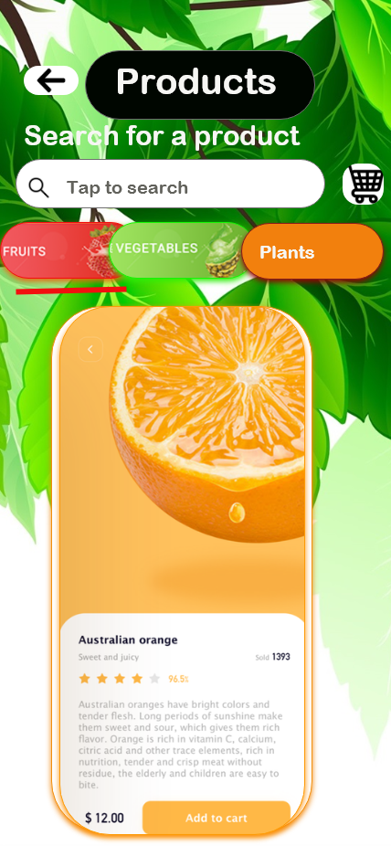
View Product
This interface can view the product by clicking on the product.It shows the all details of product. This interface is made very neatly, and get user attention. This interface is very colorful. We can search products by searching on search bar.

Slide 22
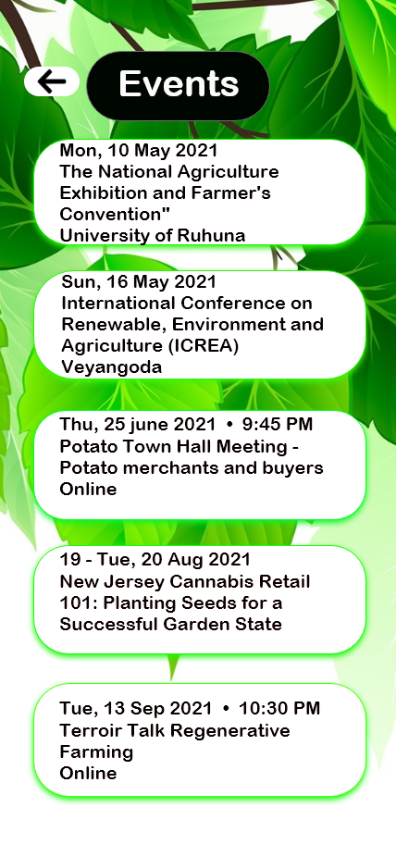
Events
This is called as events interface.It shows us events which are going to held. These events are shown as very simple way which anyone can understand by reading them. We use attractive text field to show events. Its very neat interface

Slide 23
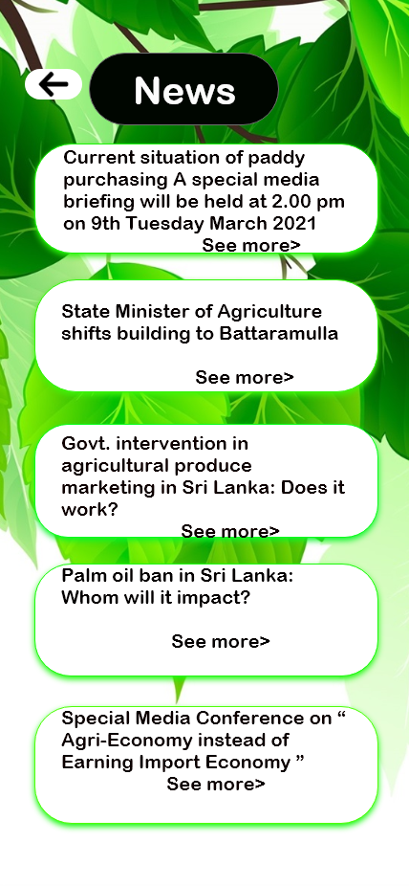
News
This is called as news interface .It shows us news about agriculture. These news are shown as very simple way which anyone can understand by reading them. We use attractive text field to show events. Its very neat interface.

Slide 24
ID :10713401
Name :U.R.K.Ukwatta

Slide 25
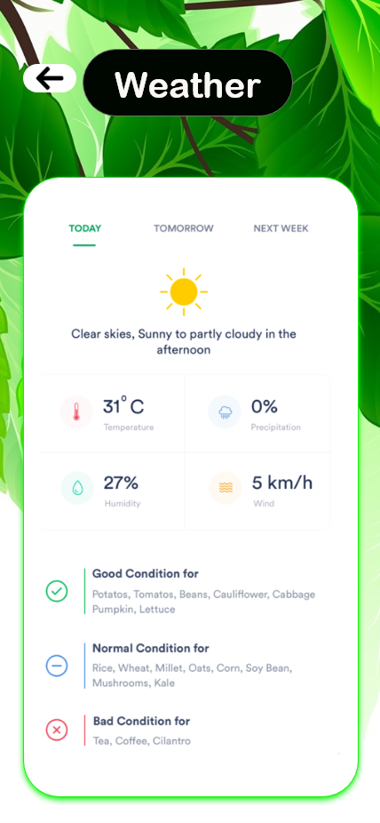
Weather - Today
This includes weather details. This includes information related to weather. The temperature, precipitation, humidity and wind are shown in the panels. It can be viewed as a today, tomorrow, and next week by the bar chart. It is very user friendly interface .We use clarity for this interface , anyone who use this interface can understand what is the function of this interface,This will increase the efficiency of the interface.

Slide 26
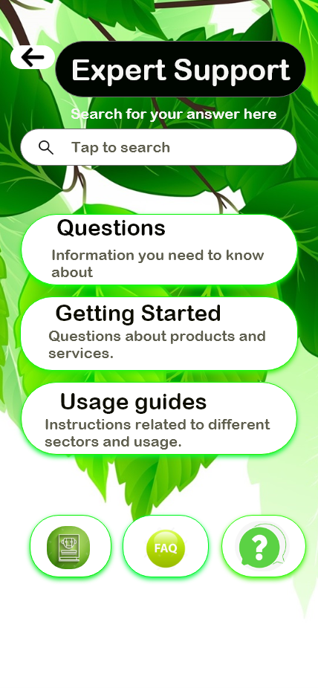
Expert Support
This is the expert support page of our agricultural information system. Here the search button allows the user to find the desired questions. The questions, getting started, and usage guides are shown in the panels. It is very user friendly interface .We use clarity for this interface , anyone who use this interface can understand what is the function of this interface,This will increase the efficiency of the interface.We use eye comfort colors,big buttons, large size font to get user attention.In this fruit product form we use icons to details then user can recognize it quickly.

Slide 27

Weather - tomorrow
This includes weather details. This includes information related to weather. The temperature, precipitation, humidity and wind are shown in the panels. It can be viewed as a today, tomorrow, and next week by the bar chart. It is very user friendly interface .We use clarity for this interface , anyone who use this interface can understand what is the function of this interface,This will increase the efficiency of the interface.

Slide 28
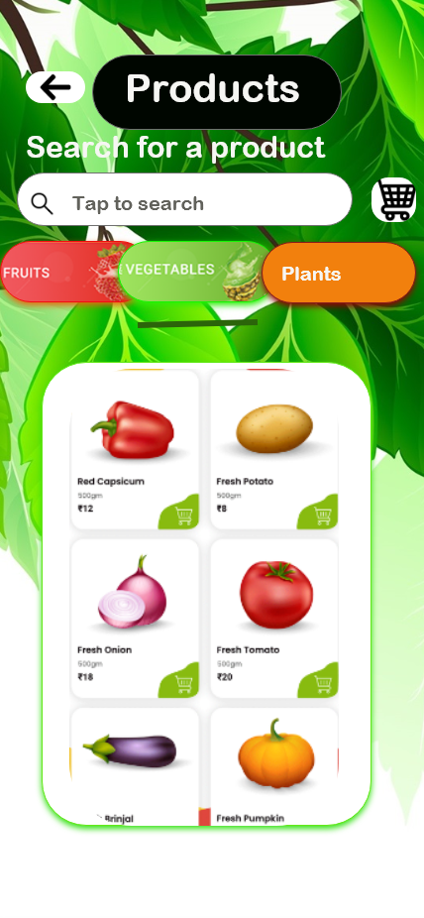
Agriculture Product -Vegetable
This is the Product page of our agricultural information system. When user click on the vegitables button it will redirect to this vegitable page. . Here the search button allows the user to find the desired vegitables. Those things added to the cart. It is very user friendly interface .We use clarity for this interface , anyone who use this interface can understand what is the function of this interface,This will increase the efficiency of the interface.We use eye comfort colors,big buttons, large size font to get user attention.In this fruit product form we use icons to details then user can recognize it quickly. After creating the UI style guide. The overall user interface design was done to keep the website having a sense of good health and full of nutrition.

Slide 29

Weather - Next week
This includes weather details. This includes information related to weather. The temperature, precipitation, humidity and wind are shown in the panels. It can be viewed as a today, tomorrow, and next week by the bar chart. It is very user friendly interface .We use clarity for this interface , anyone who use this interface can understand what is the function of this interface,This will increase the efficiency of the interface.

Slide 30
Thank you

